Slide 1
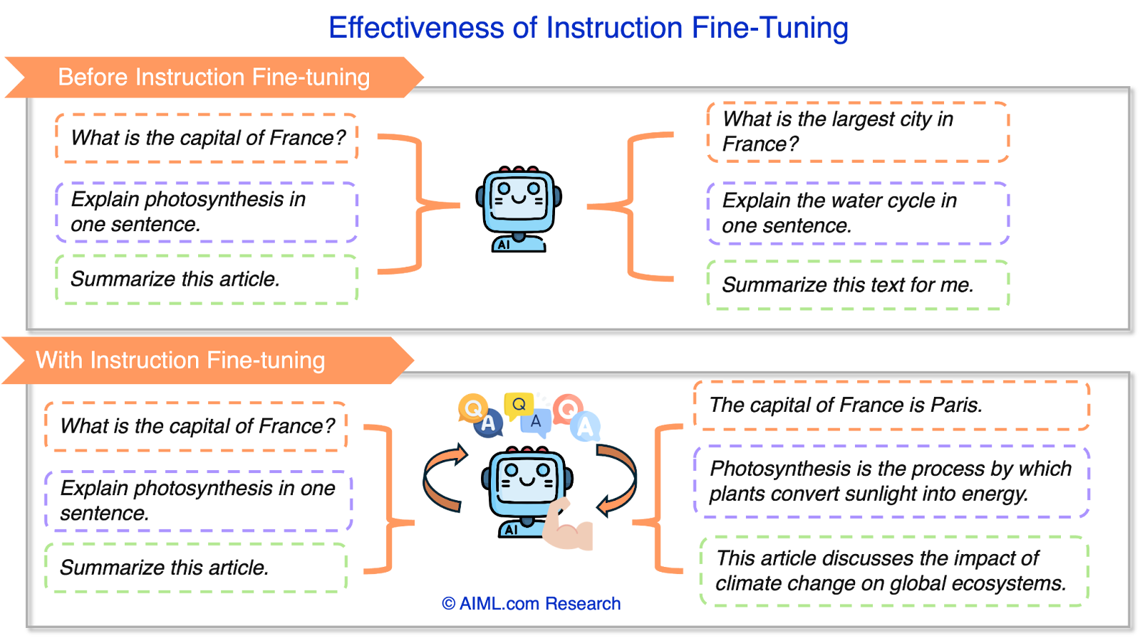
Instruction Fine-Tuning (SFT): Learning to Follow Command
Pre-trained models are essentially "document completers" that predict the next token based on a massive corpus.
Supervised Fine-Tuning (SFT) teaches the model to act as an assistant by training it on specific {Instruction, Response} pairs.
This process enables the model to understand the context of a user's command and provide a direct, helpful answer.

Slide 2
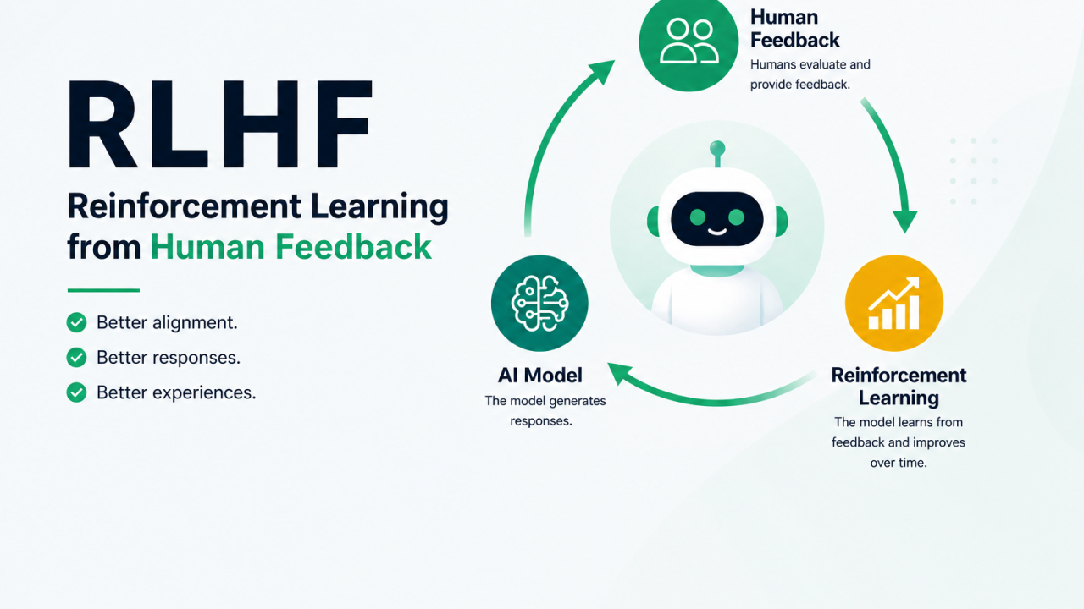
RLHF: Making AI Safe and Helpful
RLHF stands for Reinforcement Learning from Human Feedback.
Humans rank multiple model-generated responses to help the model understand which answers are better or safer.
This feedback trains a "Reward Model," which is then used to optimize the LLM's behavior so it aligns with human values.

Slide 3
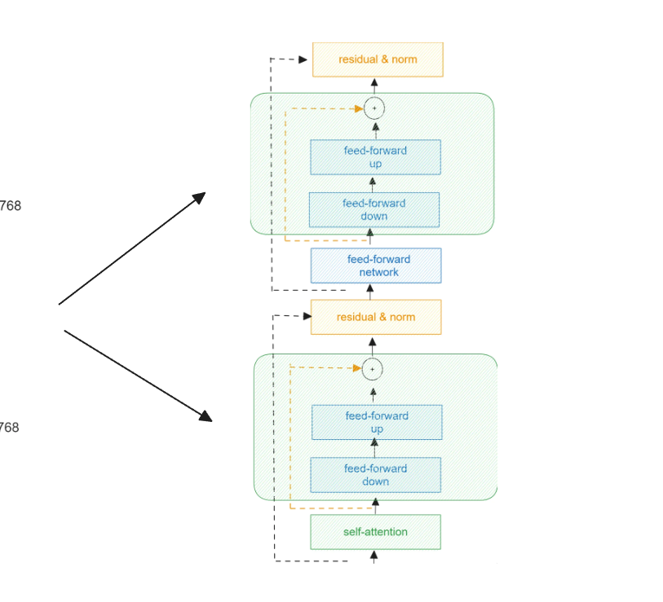
LoRA: Efficient Tuning on Local Hardware
PEFT (Parameter-Efficient Fine-Tuning) allows for tuning massive models without updating all billions of parameters.
LoRA (Low-Rank Adaptation) works by freezing the original pre-trained weights and adding small, trainable "adapter" matrices.
This drastically reduces memory requirements, making it possible to fine-tune a giant model on a cheap, local GPU.

